Slide 1
XDS.b + Blockchain
Petnathean Julled

Slide 2
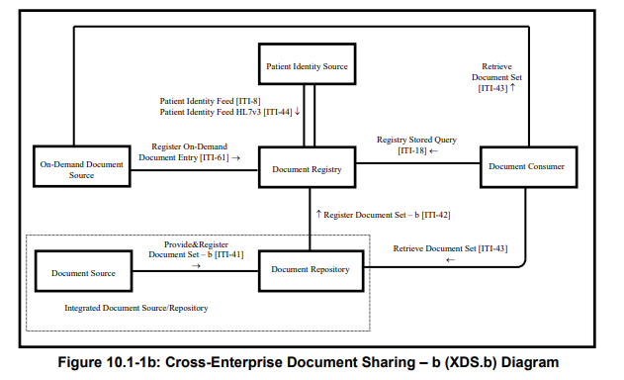
Transaction type
Notes:
There should be some kind of header that specify type of transaction

Slide 3
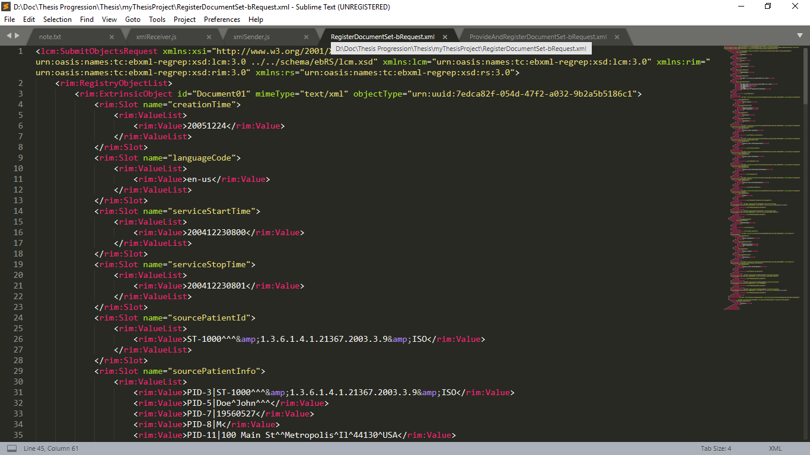
Transaction General XML Format
Header
Metadata Attributes

Slide 4
Transaction type
Notes:
There should be some kind of header that specify type of transaction

Slide 5
Transaction Provide & Register Document Set-b [ITI-41]
Provide and register Document and its metadata to Document Repository.
Document Repository expected actions
Validate and update select received metadata, as detailed below.
Make any received documents available for retrieval via the Retrieve Document Set [ITI-43] transaction.
Convey the updated metadata to the Document Registry via a Register Document Set-b [ITI-42] request.
Issue a Provide and Register Document Set-b [ITI-41] response.

Slide 6
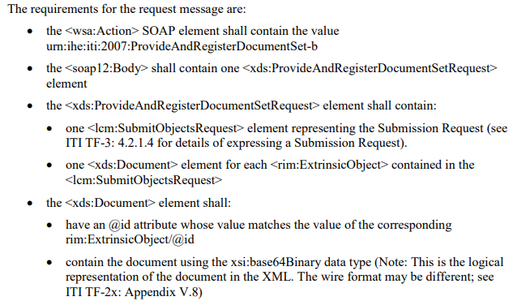
Transaction Provide & Register Document Set-b [ITI-41]

Slide 7
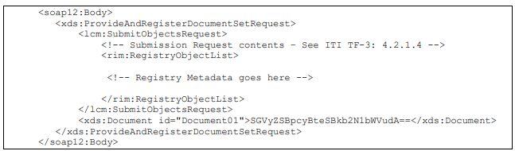
Transaction Provide & Register Document Set-b [ITI-41]

Slide 8
Transaction type
Notes:
There should be some kind of header that specify type of transaction

Slide 9
Transaction Register Document Set-b [ITI-42]
Register document metadata to Document Registry. Metadata enables the receiver to process the content of the message programmatically, without needing to understand the format or contents of the documents.
Document Registry expected actions
Perform metadata validations
Store all IHE-defined metadata attributes received so that it is available to return in responses to future queries.
Return a response message giving the status of the operation.
*If the Document Registry rejects the metadata, it shall:
Return an error including at least one error message in the response.
Roll back any changes made.

Slide 10
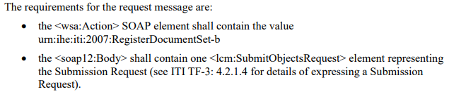
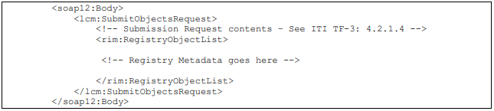
Transaction Register Document Set-b [ITI-42]

Slide 11
Transaction type
Notes:
There should be some kind of header that specify type of transaction

Slide 12
Transaction Registry Stored Query [ITI-18]
This is a query request to the Document Registry from a Document Consumer. The query request contains:
A reference to a pre-defined query stored on the Document Registry Actor.
The Registry Stored Query transaction supports a variety of pre-defined queries. Examples include the following:
Query for DocumentEntry objects by patient (Id) for a time interval on creation time and/or service time, by document type(s), by practice setting(s), by author person
Query for SubmissionSets by Document Source
Query for Folders updated during a time interval
Query for all contents in a Folder or SubmissionSet
Query for SubmissionSets by time of submission
Depending on the value of the returnType parameter, all queries return:
Metadata for one or more types of registry object, or
Object references for one or more types of registry object

Slide 13
Transaction type
Notes:
There should be some kind of header that specify type of transaction

Slide 14
Transaction Retrieve Document Set [ITI-43]
Retrieve a set of documents from the Document Repository, On-Demand Document Source.
The Document Consumer has already obtained the XDSDocumentEntry uniqueId and the Document Repository repositoryUniqueId from the Document Registry by means of the Registry Stored Query transaction.

Slide 15
Transaction Retrieve Document Set [ITI-43]
Document Repository expected actions:
A Document Repository or On-Demand Document Source shall return the document(s) indicated in the request.
The Document Repository shall return the document or an error code in case the document could not be return.
An On-Demand Document Source which supports the Persistence of Retrieved Documents Option shall save the document content returned in the retrieve response and issue a Register Document Set-b [ITI-42] transaction to register a Stable Document Entry which describes the saved document. The On-Demand Document Source shall complete the registration of the Stable Document Entry prior to responding to the Retrieve Document Set request.

Slide 16
Transaction Retrieve Document Set [ITI-43]
The registration of the new Stable Document Entry shall include:
A Submission Set
A DocumentEntry representing the Stable DocumentEntry.
A HasMember association linking DocumentEntry to SubmissionSet.
An IsSnapshotOf Association which identifies the sourceObject as the new Stable Document Entry and the targetObject as the On-Demand Document Entry which contains the uniqueID used in the Retrieve Document Set request.

Slide 17
Metadata used in Document Sharing Profile
The metadata used in Document Sharing profiles is characterized by three types of objects and two types of Associations
Three object types:
SubmissionSet = metadata describing a collection of Folders, DocumentEntries, and Associations submitted together
Folder = metadata describing a collection of related DocumentEntries
DocumentEntry = metadata describing a Document
Two Association types:
HasMember = represents membership of an object in a collection
Relationship = represents a relationship (such as a transform) between two Documents (represented by DocumentEntries)

Slide 18
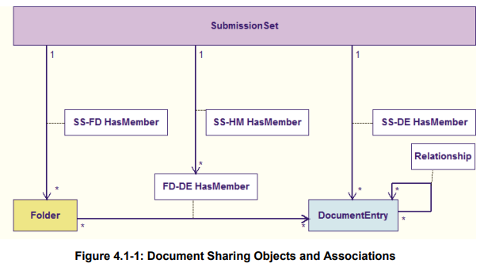
Metadata used in Document Sharing Profile

Slide 19
Metadata used in Document Sharing Profile Code
Document Sharing Object/Association | ebRIM class
DocumentEntry | rim:ExtrinsicObject
SubmissionSet | rim:RegistryPackage
Folder
MemberOf | rim:Association
Relationship

Slide 20
Metadata used in Document Sharing Profile DocumentEntry
DocumentEntry Metadata Attributes | Description | Patient identity | Provenance | Security &Privacy | Descriptive | Object Lifecycle | Exchange
author | The humans and/or machines that authored the document. This attribute contains the sub-attributes: authorInstitution, authorPerson, authorRole, authorSpecialty and authorTelecommunication. |  | ✓ | ✓ | ✓ |  | ✓
availabilityStatus | The lifecycle status of the DocumentEntry |  |  | ✓ |  | ✓
classCode | The code specifying the high-level use classification of the document type (e.g., Report, Summary, Images, Treatment Plan, Patient Preferences, Workflow). |  |  | ✓ | ✓
comment | Comments associated with the document. |  |  |  | ✓
confidentialityCode | The code specifying the level of confidentiality of the documented. |  |  | ✓
creationTime | The time the author created the document. |  | ✓ | ✓ | ✓ | ✓
entryUUID | A globally unique identifier used to manage the entry. |  |  | ✓ | ✓ | ✓ | ✓
eventCodeList | This list of codes represents the main clinical acts, such as a colonoscopy or an appendectomy, being documented. |  |  | ✓ | ✓

Slide 21
Metadata used in Document Sharing Profile DocumentEntry
DocumentEntry Metadata Attributes | Description | Patient identity | Provenance | Security &Privacy | Descriptive | Object Lifecycle | Exchange
formatCode | The code specifying the detailed technical format of the document. |  |  |  | ✓ |  | ✓
hash | The hash of the contents of the document. |  |  | ✓
healthcareFacility TypeCode | This code represents the type of organizational setting of the clinical encounter during which the documented act occurred. |  | ✓ | ✓ | ✓
homeCommunityId | A globally unique identifier for a community. |  |  |  |  |  | ✓
languageCode | Specifies the human language of character data in a document. |  |  |  | ✓
legalAuthenticator | Represents a participant within an authorInstitution who has legally authenticated or attested the document. |  | ✓ | ✓ |  | ✓
limitedMetadata | Indicates whether the DocumentEntry was created using the less rigorous requirements of metadata as defined for the Metadata-Limited Document Source. |  | ✓ |  | ✓ | ✓ | ✓
mimeType | MIME type of the document. |  |  |  | ✓ |  | ✓

Slide 22
Metadata used in Document Sharing Profile DocumentEntry
DocumentEntry Metadata Attributes | Description | Patient identity | Provenance | Security &Privacy | Descriptive | Object Lifecycle | Exchange
objectType | The type of DocumentEntry (e.g., On-Demand DocumentEntry). |  |  |  |  |  | ✓
patientId | The patientId represents the subject of care of the document. | ✓ |  | ✓ | ✓
practiceSettingCode | The code specifying the clinical specialty where the act that resulted in the document was performed (e.g., Family Practice, Laboratory, Radiology). |  | ✓ | ✓ | ✓
referenceIdList | A list of Identifiers related to the document |  | ✓ | ✓ |  | ✓
repositoryUniqueId | The globally unique identifier of the repository where the document can be accessed. |  |  | ✓ |  |  | ✓
serviceStartTime | The start time of the service being documented. |  |  | ✓ | ✓
serviceStopTime | The stop time of the service being documented. |  |  | ✓ | ✓
size | Size in bytes of the document. |  |  | ✓ |  |  | ✓

Slide 23
Metadata used in Document Sharing Profile DocumentEntry
DocumentEntry Metadata Attributes | Description | Patient identity | Provenance | Security &Privacy | Descriptive | Object Lifecycle | Exchange
sourcePatientId | The sourcePatientId represents the subject of care’s medical record identifier (e.g., Patient Id) in the local patient identifier domain of the creating entity. | ✓ | ✓ | ✓
sourcePatientInfo | This attribute contains demographic information of the source patient to whose medical record this document belongs. | ✓ | ✓
title | The title of the document. |  |  |  | ✓
typeCode | The code specifying the precise type of document from the user perspective (e.g., LOINC code). |  |  |  | ✓
uniqueId | Globally unique identifier assigned to the document by its creator. |  |  | ✓ |  |  | ✓
URI | The URI for the document. |  |  |  |  |  | ✓

Slide 24
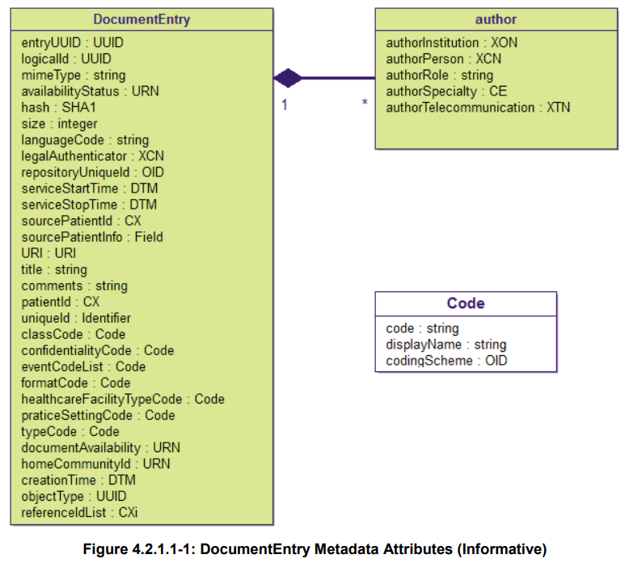
Metadata used in Document Sharing Profile DocumentEntry

Slide 25
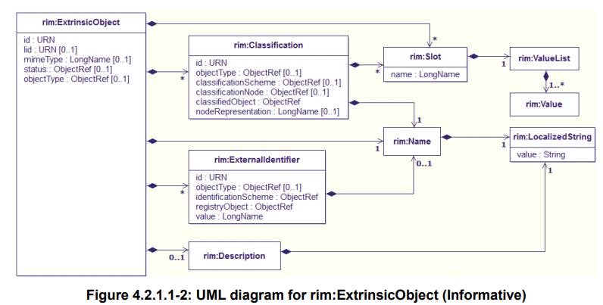
Metadata used in Document Sharing Profile DocumentEntry

Slide 26
On-Demand vs Stable Document Entry
A Stable Document Entry contain metadata about an already created document available for retrieval. Each Stable DocumentEntry represents a single document.
This document is stable because the contents have been effectively combined in the exact representation that will be returned in a Retrieve Document Set.
The uniqueID metadata attribute of a Stable DocumentEntry identifies the specific document associated with the entry. It is used in a retrieve request to identify which specific document should be retrieved.

Slide 27
On-Demand vs Stable Document Entry
An On-Demand Document Entry provides a unique identifier which can be used to create an on-demand document which collects the latest, most recent available information at the time of retrieval.
On-Demand Document Entries never reflect actual document content, but rather the potential for a document with the characteristics described in the metadata of the entry.
The uniqueID associated with an On-Demand Document Entry will never represent an actual document.
A retrieve request specifying an On-Demand Document Entry uniqueID will return content identified by a uniqueID different than the specified uniqueID.
Every On-Demand Document Entry with the same uniqueID will refer to the same potential content. Acrual content depends on the time of retrieval.
The On-Demand Document Entry uniqueID is valid for as long as the entry has availabilityStatus equal to Approved. The holder of the uniqueID may re-use it in a retrieve request to get the latest information, without the need for an additional query.
Ex. Patient status

Slide 28
On-Demand vs Stable Document Entry
An On-Demand Document Entry provides a unique identifier which can be used to create an on-demand document which collects the latest, most recent available information at the time of retrieval.
When a retrieve request is received specifying an On-Demand Document Entry uniqueID, the responder may choose to persist the document generated as a result and allow the requestor future access to metadata and document.

Slide 29
Metadata used in Document Sharing Profile SubmissionSet
DocumentEntry Metadata Attributes | Description | Patient identity | Provenance | Security &Privacy | Descriptive | Object Lifecycle | Exchange
author | The humans and/or machines that authored the SubmissionSet. This attribute contains the sub-attributes: authorInstitution, authorPerson, authorRole, authorSpecialty, authorTelecommunication. |  | ✓ | ✓ | ✓
availabilityStatus | The lifecycle status of the SubmissionSet. |  |  |  | ✓ | ✓
comments | Comments associated with the SubmissionSet. |  |  |  | ✓
contentTypeCode | The code specifying the type of clinical activity that resulted in placing the associated content in the SubmissionSet. |  | ✓ | ✓ | ✓
entryUUID | A globally unique identifier used to manage the entry. |  |  | ✓ | ✓ |  | ✓
homeCommunityId | A globally unique identifier for a community. |  |  |  |  |  | ✓
intendedRecipient | The organizations or persons for whom the SubmissionSet is intended. |  |  | ✓ |  |  | ✓
limitedMetadata | A flag that the associated SubmissionSet was created using the less rigorous metadata requirements as defined for the Metadata-Limited Document Source. |  | ✓ |  | ✓ | ✓ | ✓

Slide 30
Metadata used in Document Sharing Profile SubmissionSet
DocumentEntry Metadata Attributes | Description | Patient identity | Provenance | Security &Privacy | Descriptive | Object Lifecycle | Exchange
patientId | The patientId represents the primary subject of care of the SubmissionSet. | ✓ |  | ✓ | ✓
sourceId | Identifier of the entity that contributed the SubmissionSet. |  | ✓ | ✓ | ✓
submissionTime | Point in time at the creating entity when the SubmissionSet was created |  |  | ✓ | ✓ | ✓
title | The title of the SubmissionSet. |  |  |  | ✓
uniqueId | Globally unique identifier for the SubmissionSet assigned by the creating entity. |  |  | ✓ |  |  | ✓

Slide 31
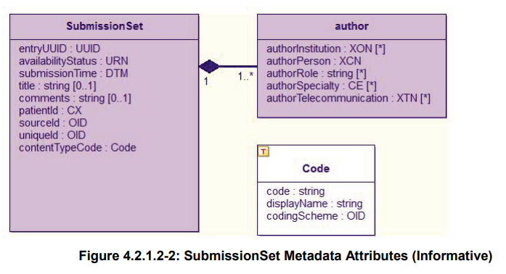
Metadata used in Document Sharing Profile SubmissionSet

Slide 32
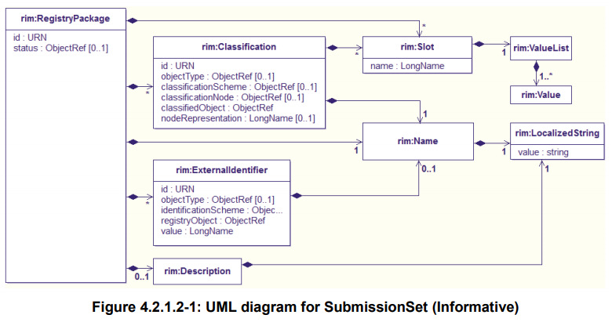
Metadata used in Document Sharing Profile SubmissionSet

Slide 33
Metadata used in Document Sharing Profile Folder
DocumentEntry Metadata Attributes | Description | Patient identity | Provenance | Security &Privacy | Descriptive | Object Lifecycle | Exchange
availabilityStatus | The lifecycle status of the Folder. |  |  | ✓ | ✓ | ✓
codeList | The set of codes specifying the type of clinical activities that resulted in placing DocumentEntry objects in the Folder. |  | ✓ | ✓ | ✓
comments | Comments associated with the Folder. |  |  |  | ✓
entryUUID | A globally unique identifier used to manage the entry. |  |  | ✓ | ✓ |  | ✓
homeCommunityId | A globally unique identifier for a community. |  |  |  |  |  | ✓
lastUpdateTime | Most recent point in time that the Folder has been modified. |  |  | ✓ |  | ✓
limitedMetadata | A flag that the associated Folder was created using the less rigorous metadata requirements as defined for the Metadata-Limited Document Source. |  | ✓ |  | ✓ | ✓ | ✓
patientId | The patientId represents the primary subject of care of the Folder. | ✓ |  | ✓ | ✓
title | The title of the Folder |  |  |  | ✓
uniqueId | Globally unique identifier for the Folder. |  |  | ✓ |  |  | ✓

Slide 34
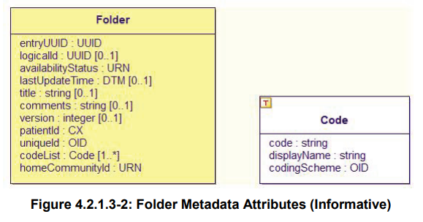
Metadata used in Document Sharing Profile Folder

Slide 35
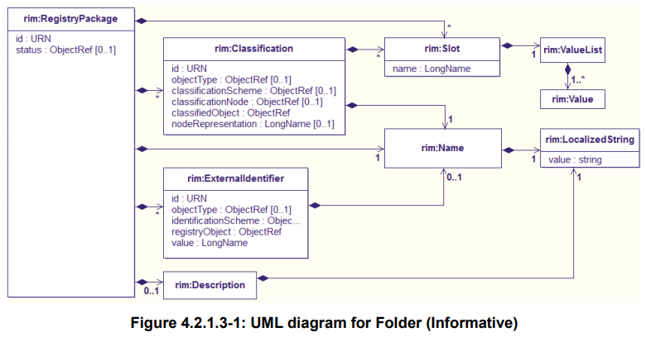
Metadata used in Document Sharing Profile Folder

Slide 36
Metadata used in Document Sharing Profile
Which metadata attributes an actor shall provide when initiating a Submission Type Transaction.
Code | Meaning
R | Required – A value for the attribute shall be supplied by the sending actor when sending the submission
R2 | Required if Known – A value for the attribute shall be supplied by the sending actor when sending the submission unless the actor does not have any value for the attribute
O | Optional – The sending actor may or may not supply a value for this attribute
X | Prohibited – when sending a submission, a value for the attribute shall not be supplied by the sending actor.

Slide 37
Metadata used in Document Sharing Profile
Which metadata attributes an actor shall provide when initiating a Submission Type Transaction.
Actor | Transaction | Shortname
XDS Document Source | Provide and Register Document Set-b [ITI-41] | XDS DS
XDS Document Repository | Register Document Set-b [ITI-42] | XDS DR
XDS On-Demand Document Source | Register On-Demand Document Entry [ITI-61] | XDS OD

Slide 38
Metadata used in Document Sharing Profile
Metadata Element | Metadata Attribute | XDS DS | XDS DR | XDS OD
DocumentEntry | author | R2 | R2 | R2
DocumentEntry | availabilityStatus | O | O | O
DocumentEntry | classCode | R | R | R
DocumentEntry | comments | O | O | O
DocumentEntry | confidentialityCode | R | R | R
DocumentEntry | creationTime | R | R | X
DocumentEntry | entryUUID | R | R | R
DocumentEntry | eventCodeList | O | O | O
DocumentEntry | formatCode | R | R | R
DocumentEntry | hash | O | R | X

Slide 39
Metadata used in Document Sharing Profile
Metadata Element | Metadata Attribute | XDS DS | XDS DR | XDS OD
DocumentEntry | healthcareFacilityTypeCode | R | R | R
DocumentEntry | homeCommunityId | O | O | O
DocumentEntry | languageCode | R | R | R
DocumentEntry | legalAuthenticator | O | O | O
DocumentEntry | limitedMetadata | X | X | X
DocumentEntry | mimeType | R | R | R
DocumentEntry | objectType | R | R | R
DocumentEntry | patientId | R | R | R
DocumentEntry | practiceSettingCode | R | R | R
DocumentEntry | referenceIdList | O | O | O

Slide 40
Metadata used in Document Sharing Profile
Metadata Element | Metadata Attribute | XDS DS | XDS DR | XDS OD
DocumentEntry | repositoryUniqueId | O | R | R
DocumentEntry | serviceStartTime | R2 | R2 | O
DocumentEntry | serviceStopTime | R2 | R2 | O
DocumentEntry | size | O | R | X
DocumentEntry | sourcePatientId | R | R | R
DocumentEntry | sourcePatientInfo | O | O | O
DocumentEntry | title | O | O | O
DocumentEntry | typeCode | R | R | R
DocumentEntry | uniqueId | R | R | R
DocumentEntry | URI | O | O | O

Slide 41
Metadata used in Document Sharing Profile
Metadata Element | Metadata Attribute | XDS DS | XDS DR | XDS OD
SubmissionSet | author | R2 | R2 | R2
SubmissionSet | availabilityStatus | O | O | O
SubmissionSet | comments | O | O | O
SubmissionSet | contentTypeCode | R | R | R
SubmissionSet | entryUUID | R | R | R
SubmissionSet | homeCommunityId | O | O | O
SubmissionSet | intendedRecipient | O | O | O
SubmissionSet | limitedMetadata | X | X | X
SubmissionSet | patientId | R | R | R
SubmissionSet | sourceId | R | R | R

Slide 42
Metadata used in Document Sharing Profile
Metadata Element | Metadata Attribute | XDS DS | XDS DR | XDS OD
SubmissionSet | submissionTime | R | R | R
SubmissionSet | title | O | O | O
SubmissionSet | uniqueId | R | R | R
Folder | availabilityStatus | O | O | O
Folder | codeList | R | R | R
Folder | comments | O | O | O
Folder | entryUUID | R | R | R
Folder | homeCommunityId | O | O | O
Folder | lastUpdateTime | O | O | O
Folder | limitedMetadata | X | X | X

Slide 43
Metadata used in Document Sharing Profile
Metadata Element | Metadata Attribute | XDS DS | XDS DR | XDS OD
Folder | patientId | R | R | R
Folder | title | R | R | R
Folder | uniqueId | R | R | R

Slide 44
Metadata used in Document Sharing Profile
Which metadata attributes shall contain content in a response to a query transaction.
Actor | Transaction | Shortname
XDS Document Registry | Registry Stored Query [ITI-18] | XDS DR

Slide 45
Metadata used in Document Sharing Profile
Which metadata attributes shall contain content in a response to a query transaction.
Code | Meaning
R | Required – A value for the attribute shall be supplied by the responding actor when responding to a query
R2 | Required if Known – A value for the attribute shall be supplied by the responding actor when responding to the query if a value is available to the actor. For the Document Registry it must supply the value specified in the submission request.
O | Optional – The responding actor may or may not supply a value for this attribute. For the Document Registry it must supply the value specified in the submission request.
X | Prohibited – when responding to a query, a value for the attribute shall not be supplied by the responding actor.
R3 | Required for Stable DocumentEntries and not allowed for On-Demand DocumentEntries.

Slide 46
Metadata used in Document Sharing Profile
Metadata Element | Metadata Attribute | XDS DR
DocumentEntry | author | R2
DocumentEntry | availabilityStatus | R
DocumentEntry | classCode | R
DocumentEntry | comments | O
DocumentEntry | confidentialityCode | R
DocumentEntry | creationTime | R3
DocumentEntry | entryUUID | R
DocumentEntry | eventCodeList | O
DocumentEntry | formatCode | R
DocumentEntry | hash | R3

Slide 47
Metadata used in Document Sharing Profile
Metadata Element | Metadata Attribute | XDS DR
DocumentEntry | healthcareFacilityTypeCode | R
DocumentEntry | homeCommunityId | O
DocumentEntry | languageCode | R
DocumentEntry | legalAuthenticator | O
DocumentEntry | limitedMetadata | X
DocumentEntry | mimeType | R
DocumentEntry | objectType | R
DocumentEntry | patientId | R
DocumentEntry | practiceSettingCode | R
DocumentEntry | referenceIdList | O

Slide 48
Metadata used in Document Sharing Profile
Metadata Element | Metadata Attribute | XDS DR
DocumentEntry | repositoryUniqueId | R
DocumentEntry | serviceStartTime | R2
DocumentEntry | serviceStopTime | R2
DocumentEntry | size | R3
DocumentEntry | sourcePatientId | R
DocumentEntry | sourcePatientInfo | O
DocumentEntry | title | O
DocumentEntry | typeCode | R
DocumentEntry | uniqueId | R
DocumentEntry | URI | O

Slide 49
Metadata used in Document Sharing Profile
Metadata Element | Metadata Attribute | XDS DR
SubmissionSet | author | R2
SubmissionSet | availabilityStatus | R
SubmissionSet | comments | O
SubmissionSet | contentTypeCode | R
SubmissionSet | entryUUID | R
SubmissionSet | homeCommunityId | O
SubmissionSet | intendedRecipient | O
SubmissionSet | limitedMetadata | X
SubmissionSet | patientId | R
SubmissionSet | sourceId | R

Slide 50
Metadata used in Document Sharing Profile
Metadata Element | Metadata Attribute | XDS DR
SubmissionSet | submissionTime | R
SubmissionSet | title | O
SubmissionSet | uniqueId | R
Folder | availabilityStatus | R
Folder | codeList | R
Folder | comments | O
Folder | entryUUID | R
Folder | homeCommunityId | O
Folder | lastUpdateTime | O
Folder | limitedMetadata | X

Slide 51
Metadata used in Document Sharing Profile
Metadata Element | Metadata Attribute | XDS DR
Folder | patientId | R
Folder | title | R
Folder | uniqueId | R

Slide 52
Which attributes need encrypt?
sourcePatientInfo
This attribute contains demographic information of the source patient to whose medical record this document belongs.
Coded as an ebRIM Slot. If present, each rim: Value contains a Field. Multiple rim:Value elements may exist for the same field name as a way to implement repetition; there shall be at most one rim: Value element for each of the PID-7 and PID-8 fields. Only field defined for the PID segment shall be used.
Maximum length of each rim: Value is 256 characters. The sourcePatientInfo attribute should include:
PID-3 (source patient identifier list)
PID-5 (source patient name)
If multiple patient names are present, then PID-5.7 “Name Type Code” and PID-5.8 “Name Representation Code” should be valued in each entry.
PID-7 (source patient date of birth)
PID-8 (source patient gender)
*The sourcePatientInfo attribute should not include values for PID-2 (patient id), PID-4 (alternate patient id), PID-12 (country code), or PID-19 (social security number).

Slide 53
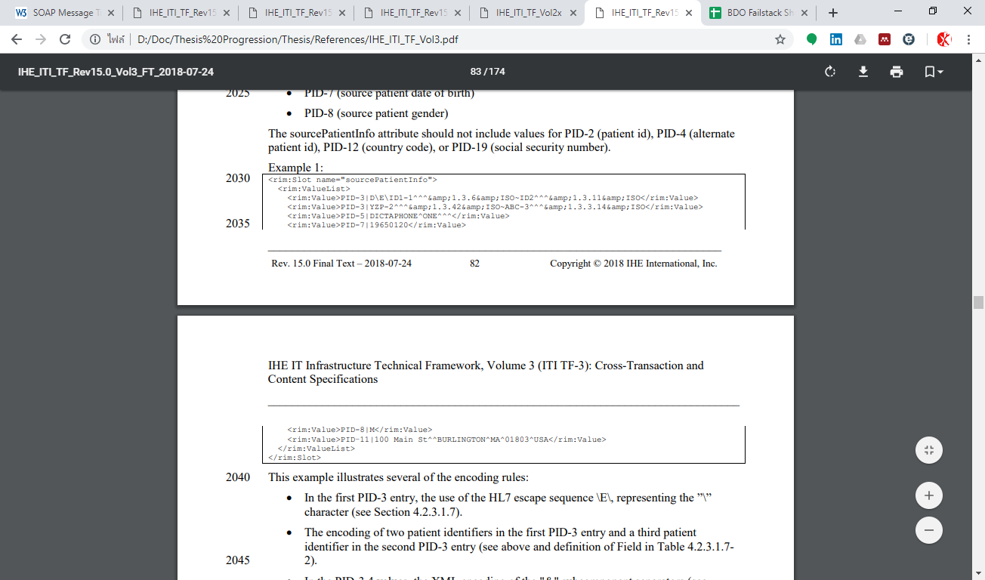
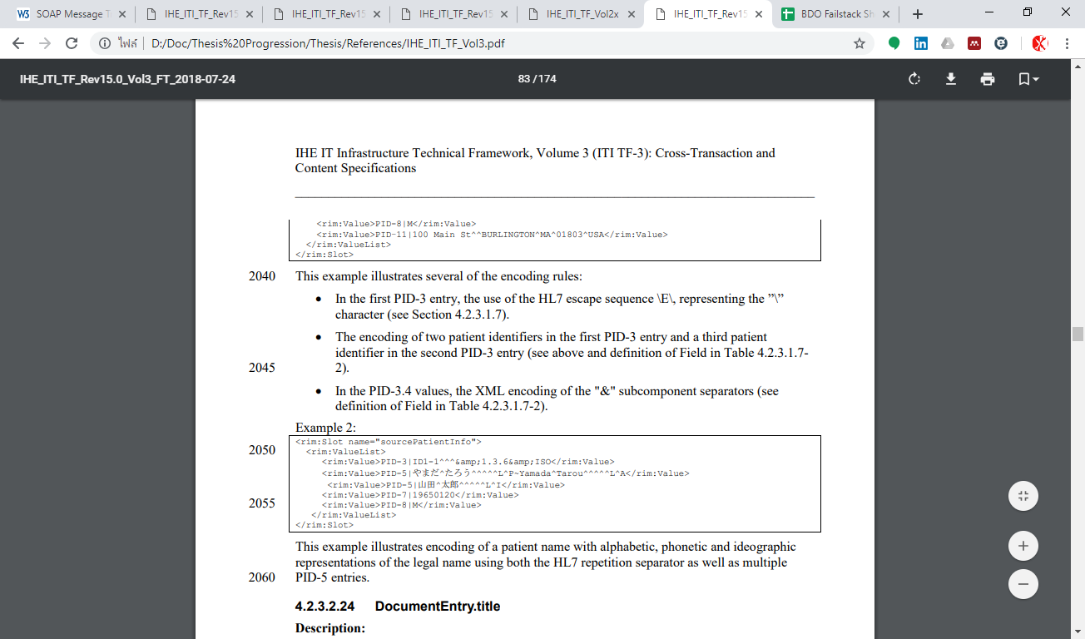
Which attributes need encrypt?

Slide 54
Which attributes need encrypt?

Slide 55
มีแบบตอบกลับ consumer แบบเลือก attribute มั้ย (all or nothing หรือ selective)
ใน transaction มี option ให้ขอแค่บางส่วนหรือเปล่า

